Slide 1







Data Technologies Survey Insights
Kevin Pham
04/15/2024

Slide 2



OUTLINE
Executive Summary
Introduction
Methodology
Results
Visualization – Charts
Dashboard
Discussion
Findings & Implications
Conclusion

Slide 3

EXECUTIVE SUMMARY
Analysis of Stack Overflow Survey
Respondents were asked about various Data Technologies
E.g. Programming Languages, database usage
Asked about current usage as well as languages they wished to learn in the next year
Demographics of participants also recorded
Overall demographics: primarily male, aged 22-30, from the USA
Found that SQL databases remain very popular, and will have more users learning them within the next year
Python’s userbase is also expected to grow
Older databases like Oracle may have fewer users in coming years

Slide 4

INTRODUCTION
Data is an ever-evolving field, highly dependent on ever-evolving tools
Tools, such as languages and databases, are most useful when many other users also use it (mutual support, ease of use and debugging)
Knowing the data landscape can be of importance to both companies and learners
Companies know which tools to invest in
Learners know which tools to study

Slide 5

METHODOLOGY
The data used was from the 2019 StackOverflow Developer survey, a survey conducted on 90,000 developers
Data was cleaned and analyzed using Python and Excel
Visualizations were performed using IBM Cognos Analytics
Some supplemental visualizations (slides 18-19) were Webscraped using Python, with visualizations created using Excel and Python

Slide 6
RESULTS

Slide 7
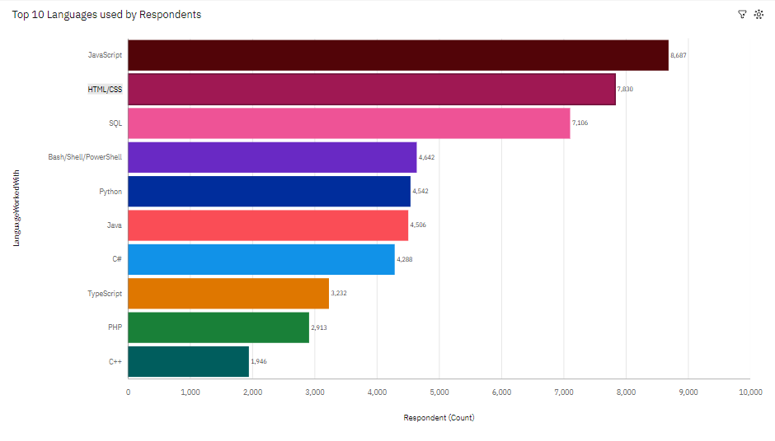
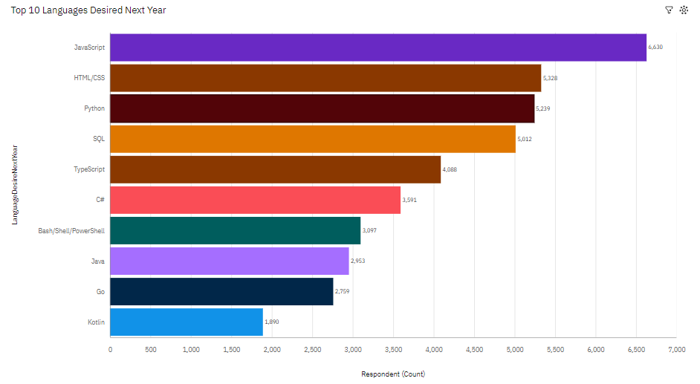
PROGRAMMING LANGUAGE TRENDS
Current Year – Top 10 Languages
Next Year – Top 10 Databases

Slide 8
PROGRAMMING LANGUAGE TRENDS - FINDINGS & IMPLICATIONS
Findings
Javascript and HTML/CSS most popular languages, both currently and desired
C++ lowest among top 10 current languages, not present in top 10 desired languages
Many current Python users, and 3rd highest among desired languages
Implications
JS and HTML will continue to be popularly used programming languages
C++ may become less popular in the next year, fewer participants desire to learn it.
Python’s userbase may be expected to grow – high among desired languages

Slide 9
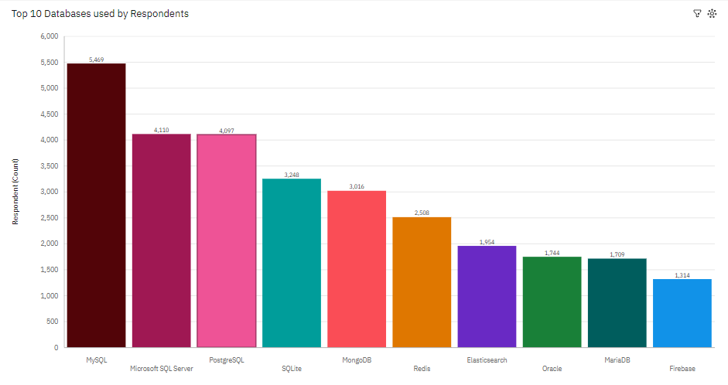
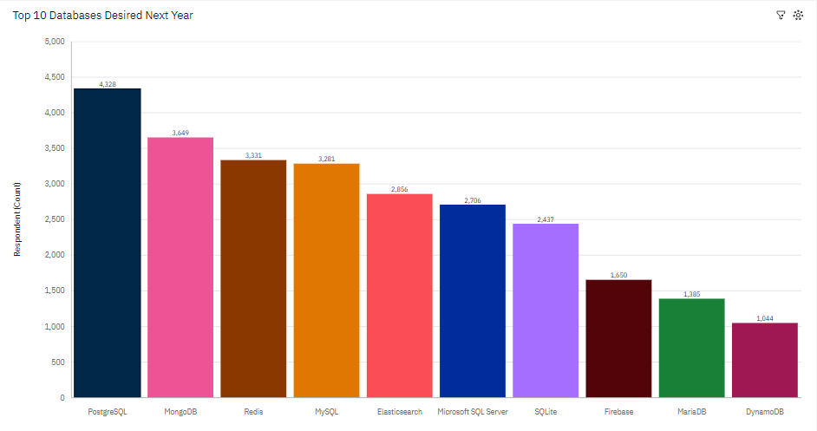
DATABASE TRENDS
Current Year – Top 10 Databases
Next Year – Top 10 Databases

Slide 10
DATABASE TRENDS - FINDINGS & IMPLICATIONS
Findings
SQL variants common in current and desired databases
Redis, MongoDB and Elasticsearch have more desired users than current users
Despite being top 10 current users, Oracle is not in the top 10 desired
Implications
SQL will continue to be a popularly used database
Can expect Redis, MongoDB, and Elasticsearch to grow in the next year
Can expect Oracle to become less popular in the following year

Slide 11

DASHBOARD
https://github.com/K-C-Pham/Data_Technologies_Project

Slide 12
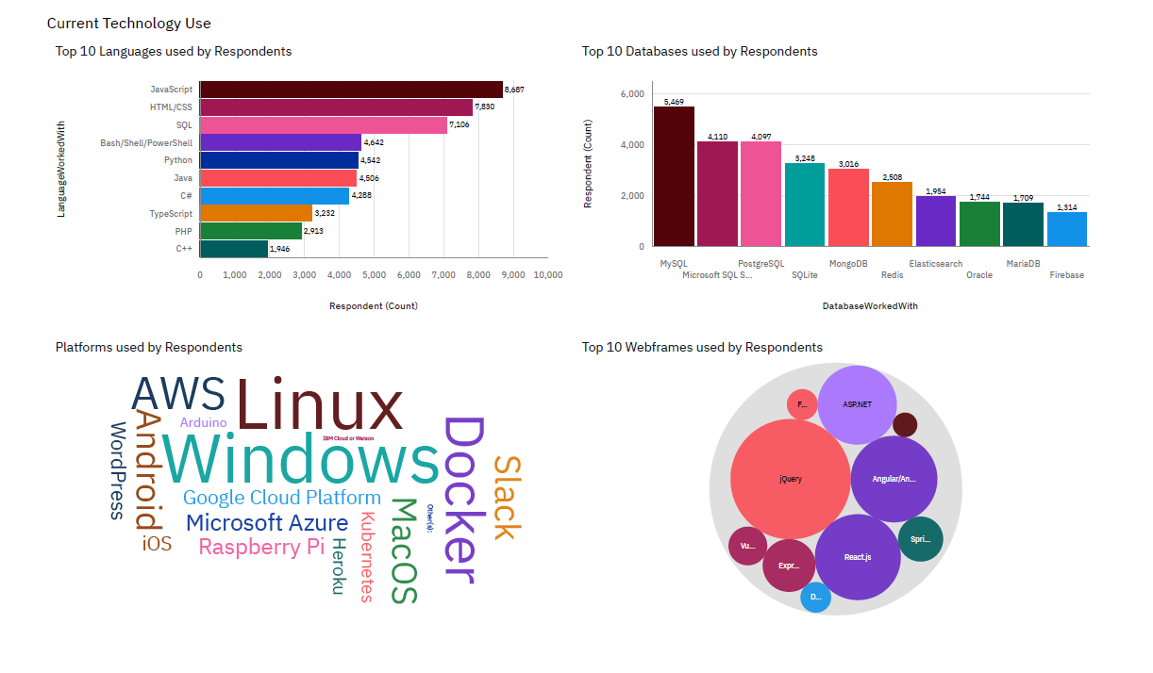
DASHBOARD TAB 1

Slide 13
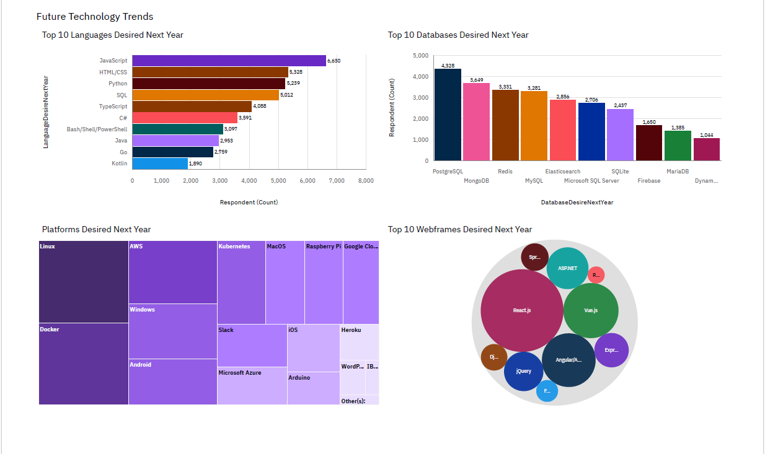
DASHBOARD TAB 2

Slide 14
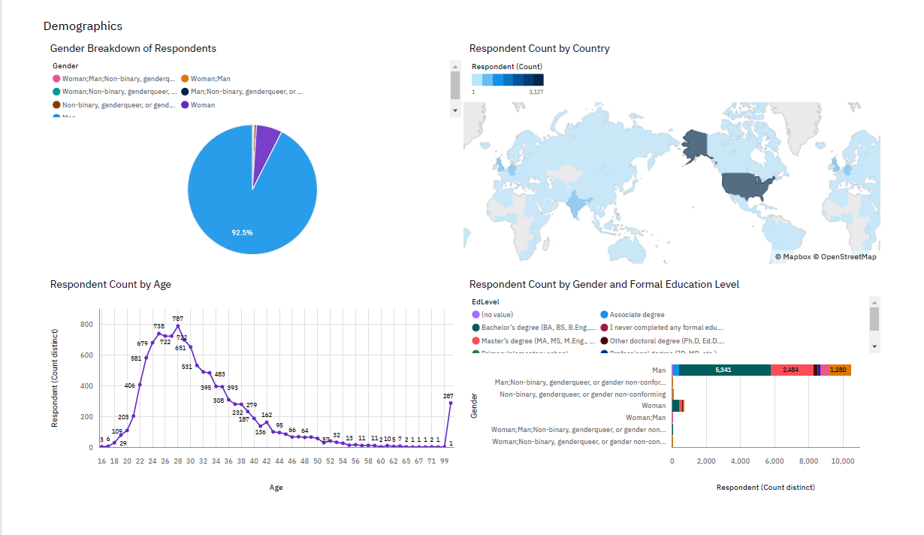
DASHBOARD TAB 3

Slide 15
DISCUSSION

Slide 16
OVERALL FINDINGS & IMPLICATIONS
Findings
Many SQL types are currently used and desired to be learned
Python is extremely popular, both currently and desired
Some databases such as Oracle are currently popular but not very desired
Overwhelming majority of respondents were Male
Implications
SQL is, and will remain a popular database in the coming year
Python remains a very popular programming language with a continuously growing userbase
Older databases like Oracle may have a shrinking user base in the future
Suggests that most people who use StackOverflow are male, but may also be indicative of overall data field

Slide 17

CONCLUSION
While the sample was limited to StackOverflow, the nature of the website as a Q&A site for programmers means that the sample is representative of the industry
It is important to know which languages and databases are most prevalent in the industry – for learners, companies, and users alike
Some older technologies may have fallen out of favor – can tell by lower prevalence in desired learning

Slide 18
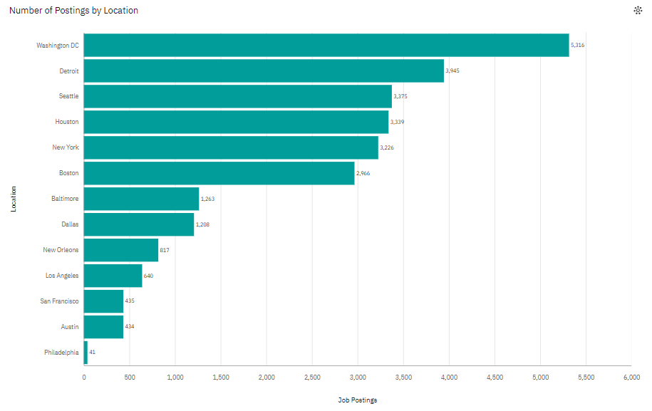
JOB POSTINGS

Slide 19
POPULAR LANGUAGES

